Slide 1
Chapter 17. Applying Patterns to Design a Persistence Framework

Slide 2
Bridge Pattern

Slide 3
Intent
Decouple an abstraction from its implementation so that the two can vary independently.
16-<number>

Slide 4
Also Known As
Handle/Body
16-<number>

Slide 5
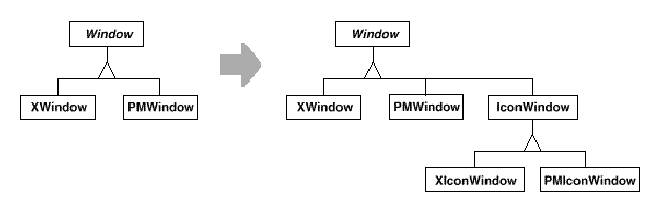
Motivation
To support IconWindows for both platforms, we have to implement two new classes, XIconWindow and PMIconWindow.
Clients should be able to create a window without committing to a concrete implementation.
13-<number>

Slide 6
Applicability
Use the Bridge pattern when
you want to avoid a permanent binding between an abstraction and its implementation.
both the abstractions and their implementations should be extensible by subclassing.
changes in the implementation of an abstraction should have no impact on clients.
you want to hide the implementation of an abstraction completely from clients.
you want to share an implementation among multiple objects (perhaps using reference counting), and this fact should be hidden from the client.
16-<number>

Slide 7
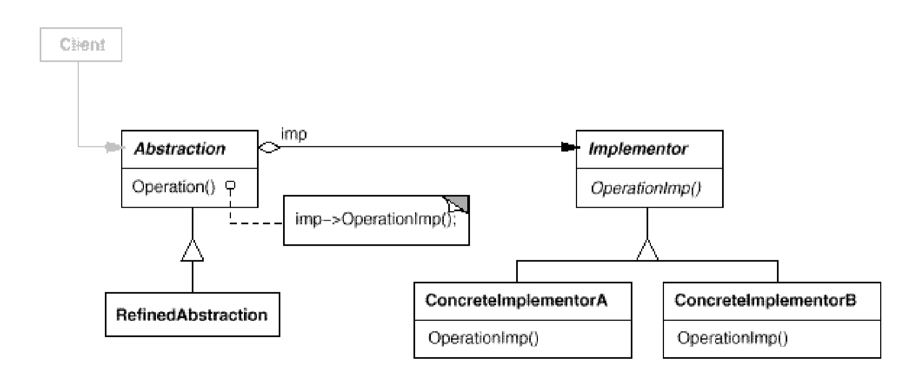
Structure
17-<number>

Slide 8
Motivating Example: Consider This Design
:Checkout
GUI
:Checkout
Controller
<<retrieve patron info
and document info>>
<<uid,
cnList>>
msg:=checkout
(uid, cnList): String
<<patron info and
document info>>
<<msg>>
msg:=processCheckout(): String
<<update db>>
What is “wrong” with it?
17-<number>

Slide 9
Problems with the Design
The controller has to know how to work with a database.
The controller may also need to know the business logic.
Since every controller works with a database, much database access code is duplicated.
If a different type of database is used, the controller has to be changed.
If the database is on a remote machine, the controller also has to implement network protocols.
If the needed information is distributed over several databases, the controller has to work with all of the databases.
17-<number>

Slide 10
Applying Separation of Concerns
Separation of concerns is a software design principle (Edsger W. Dijkstra).
Separate database concerns from the business logic concerns.
The database concerns are separated and delegated to another object (class) – the database manager.
17-<number>

Slide 11
Delegate DB Concerns to a DB Manager
:Checkout
Controller
:DBMgr
u:User
b:Book
<<JDBC/ODBC>>
msg:=checkout
(uid, cnList): String
u:=getUser(uid): User
RDB
u:=isNew()
[u!=null & cn in cnList]*:
process(cn)
l:Loan
b:=getBook
(cn): Book
a:=isAvailable()
[a] create(u,d)
[a] saveLoan(l)
[a] setAvailable(false)
[a] saveBook(b)
17-<number>

Slide 12
Database Manager
It hides the database from the controller.
It is a bridge between the controller and the database.
It constructs the business objects from database records.
DB manager design considerations:
  What if the database is at a remote site?
  What if the DBMS is changed from SQL to Oracle?
  What if multiple databases are used?
17-<number>

Slide 13
Applying Bridge Pattern
DBMgr
DBAccessImpl
getUser(uid):User
getBook(callNo):Book
saveLoan(loan)
saveBook(book)
getUser(uid):User
getBook(callNo):Book
saveLoan(loan)
saveBook(book)
...
Italic means abstract or interface.
impl
Dash line means implements.
imp.saveBook(book)
LDAPAccess
OracleAccess
SQLAccess
getUser(uid):User
getBook(callNo):Book
saveLoan(loan)
saveBook(book)
...
getUser(uid):User
getBook(callNo):Book
saveLoan(loan)
saveBook(book)
...
getUser(uid):User
getBook(callNo):Book
saveLoan(loan)
saveBook(book)
...
17-<number>

Slide 14
Bridge Pattern Sample Code
interface DBAccessImpl {
  public User getUser(String uid);
  public Book getBook(String callNo);
  public void saveLoan(Loan loan);
  public void saveBook(Book book);
}
public class LDAPAccess implements DBAccessImpl
{
  public User getUser(String uid)
  { /** get a User object from the LDAP DB*/ }
  public Book getBook (String callNo)
  { /** get a Book object from the LDAP DB */ }
  public void saveLoan(Loan loan)
  { /** save a Loan object to the LDAP DB */ }
  public void saveBook(Book book)
  { /** save a Book object to the LDAP DB */ }
}
Oracle Access and SQL Access are
implemented similarly.
17-<number>

Slide 15
Bridge Pattern Sample Code
One way to change the DB access dynamically.
DBMgr
public class DBMgr
{
  DBAccessImpl imp;
  public DBMgr() {
  ...
  imp=Config.getInstance().
  getDB();
  }
  public User getUser (String uid)
  { return imp.getUser (uid); }
  public Book getBook (String callNo)
  { return imp.getBook (callNo); }
  public void saveLoan (Loan loan)
  { imp.saveLoan (loan); }
  public void saveBook (Book book)
  { imp.saveBook (book); }
}
getUser(uid):User
getBook(callNo):
Book
saveLoan(loan)
saveBook(book)
impl
DBAccessImpl
getUser(uid):User
getBook(callNo):
Book
saveLoan(loan)
saveBook(book)
...
return imp.getUser(uid);
LDAPAccess
OracleAccess
SQLAccess
getUser(uid):User
getBook(callNo):
Book
saveLoan(loan)
saveBook(book)
...
getUser(uid):User
getBook(callNo):
Book
saveLoan(loan)
saveBook(book)
...
getUser(uid):User
getBook(callNo):
Book
saveLoan(loan)
saveBook(book)
...
17-<number>

Slide 16
Bridge Pattern Sample Code
:Checkout
Controller
public class CheckoutController {
DBMgr dbm=new DBMgr();
...
public String checkout (String uid, String cn) {
User u=dbm.getUser();
if (u!=null) return process(cn, u);
}
public String process (String cn, User u)
{
Book b=dbm.getBook(cn);
if (b.isAvailable()) {
Loan l=new Loan (u, b);
dbm.saveLoan(l);
b.setAvailable(false);
dbm.saveBook(b);
}
...
}
:DBMgr
msg:=checkout
(uid, cn): String
u:=getUser(uid):
User
[u!=null] msg:=process(cn, u): String
b:=getBook(cn):
Book
to Book
a:=isAvailable()
to Loan
[a]create(u,b)
[a]saveLoan(l)
to Book
[a]setAvailable(false)
[a]saveBook(b)
17-<number>

Slide 17
The Bridge Pattern
Decouples the client interface from its implementation.
Lets the client interface and implementation change independently.
Hides the implementation details from the client – it does not know which implementation it is using.
Often used to design systems that require the flexibility to change the client interface or implementation dynamically.
17-<number>

Slide 18
Potential Problems
DBMgr
DBAccessImpl
getUser(uid):User
getBook(callNo):Book
saveLoan(loan)
saveBook(book)
getUser(uid):User
getBook(callNo):Book
saveLoan(loan)
saveBook(book)
...
impl
If DBMgr has many functions, then each concrete DB access class will have thousands of lines of code.
LDAPAccess
OracleAccess
getUser(uid):User
getBook(callNo):Book
saveLoan(loan)
saveBook(book)
...
getUser(uid):User
getBook(callNo):Book
saveLoan(loan)
saveBook(book)
...
17-<number>

Slide 19
Remarks
What are the similarities and differences between Adapter and Bridge?
What are the similarities and differences between Strategy and Bridge?
Can you think of situations in which one of these patterns should be applied but the other should not?
16-<number>

